Slide 1
ENHANCED CYBER-PHYSICAL SECURITY IN Internet of things through energy auditing
Under the Guidance of: Presentation By:
Dr. S Mohideen Badusha Niharika G V
Senior Professor 4AL16CS059

Slide 2
CONTENTS
Introduction
Statement of the problem
Objectives
Need for the study
Methodology
Applications
Conclusion
References

Slide 3
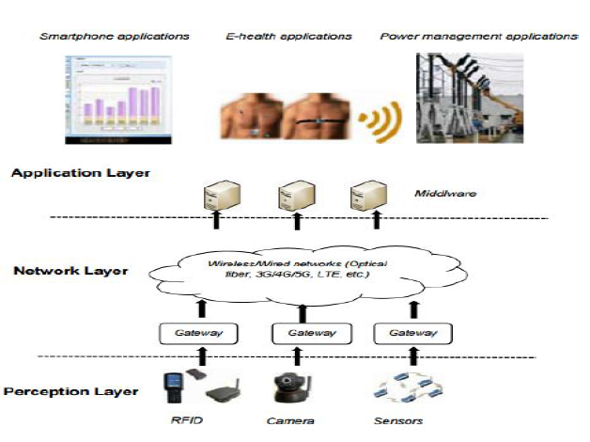
INTRODUCTION
Internet of Things (IOT) face complex and complicated security challenges from both the cyber and physical channels.
In an IoT system, the perception and application layers have the physical attack vulnerabilities, while the network layer is facing possible cyber attacks.
When IoT systems carry ubiquitous computing, IoT devices are physically reachable, thus physical threats and attacks become possible.
Fig: Three Layers of IoT Architecture

Slide 4
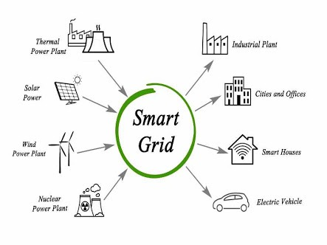
CONT..
As system logs are also attack targets and can be forged, IoT security should depend on a more “reliable” system monitoring mechanism
Energy auditing has been investigated in the emerging smart grids, but has not been known as a major attack target.
Furthermore, the energy auditing channel can be encrypted, if needed.
The hypothesis is that cyber or physical attacks leave a trace in the energy profile. If an attack does not affect energy profile at all, it would perhaps be negligible.

Slide 5
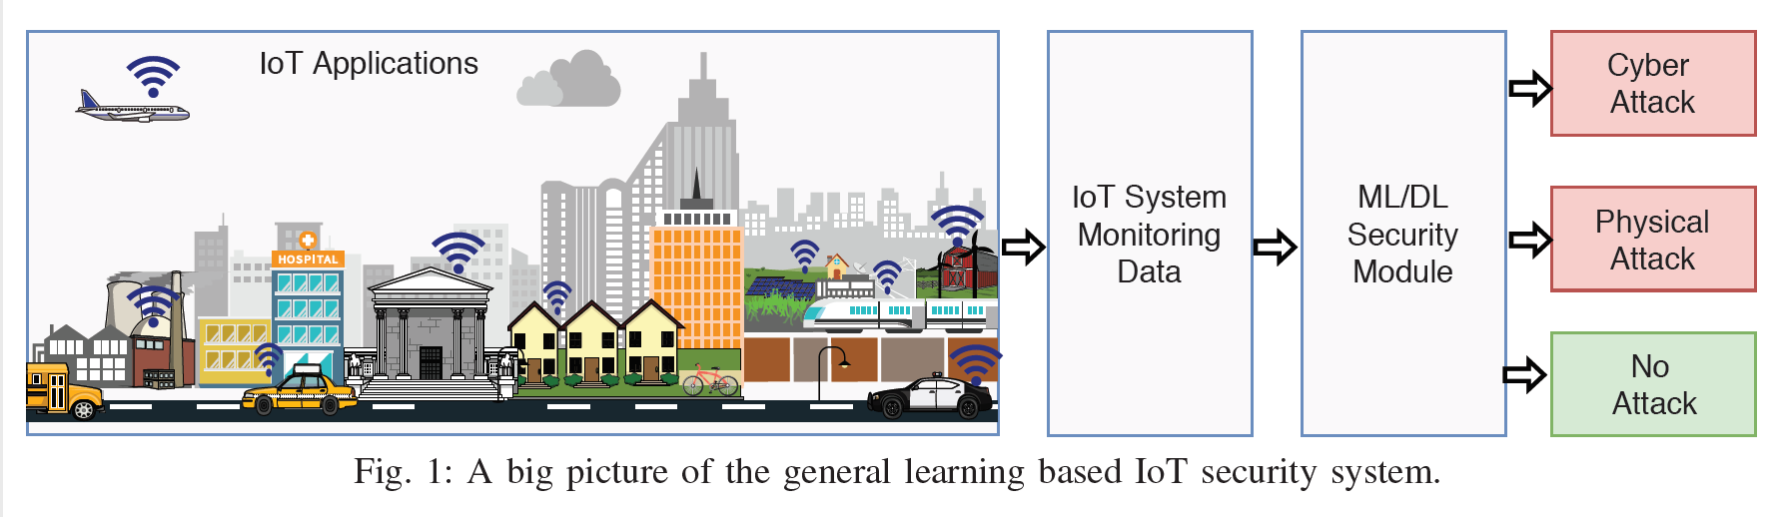
CONT..
Figure 1 shows the big picture of the proposed IoT security mechanism

Slide 6
STATEMENT OF THE PROBLEM
Traditionally, attacks are detected via monitoring system logs.
However, the system logs, such as network statistics, file access records, can be forged.
Furthermore, existing solutions mainly target cyber attacks.
Due to limited processing, storage and communication resources as well as the unpredictable physical environment, traditional security software solutions are too heavy for IoT devices and often cannot detect physical threats

Slide 7
OBJECTIVES
To detect and identify IoT cyber and physical attacks based on energy auditing using the energy meter readings.
Propose a disaggregation-aggregation architecture instead of the previous single deep learning models for energy disaggregation.

Slide 8
SCOPE FOR THE STUDY
In recent years there has been a rapid development seen in IoT in the areas of Tele medicine, Intelligent Transportation systems, and Pollution Monitoring Systems etc
The future degrees are given below keeping in mind the end goal to make the IoT worldview more secure:
Architectural standards
Identity Management
Session Layer

Slide 9
NEED FOR THE STUDY
Iot can be affected by various categories of security threats like common worms jumping, script kiddies, organized crime, cyber terrorism etc
Hardware, software and connectivity will all need to be secure for IoT objects to work effectively.
Without security, any connected object can be hacked.

Slide 10
METHODOLOGY
The proposed system is designed to be sensitive to the abnormal energy pattern changes caused by physical and cyber attacks.
In terms of physical attacks, energy changes due to tampering, physical damage, jamming, etc., can be detected and identified.
Speaking of cyber attacks, network and software attacks are the targets, including DoS, unauthorized access, virus and worms, Trojan horse, etc..
Energy anomaly is the evidence of attacks, furthermore, different energy patterns indicate the attack types.

Slide 11
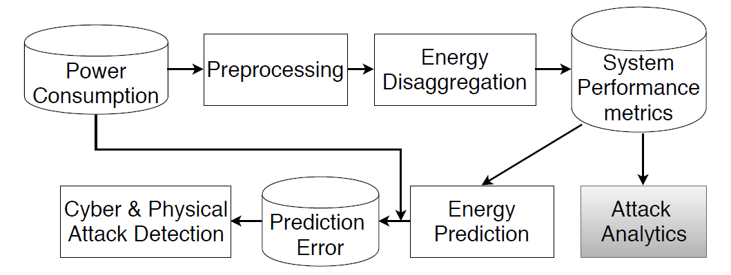
ALGORITHM DESIGN
The following Workflow( Fig2 ) and the algorithm that shall be discussed show the whole end-to-end system operation workflow.
The proposed IoT security analytics system is shown in Figure 2
Fig. 2: Workflow of the proposed IoT security system

Slide 12
Algorithm : Proposed IoT Security System
Input : Energy audit reading of the IoT device
Output: Whether the device is compromised
Preprocessing
Energy disaggregation
If applicable, the disaggregated performance metrics are compared with the ground truth to indicate which IoT component is not behaving normal.
Anomaly detection based on the prediction error
System performance metrics aggregation for energy prediction

Slide 13
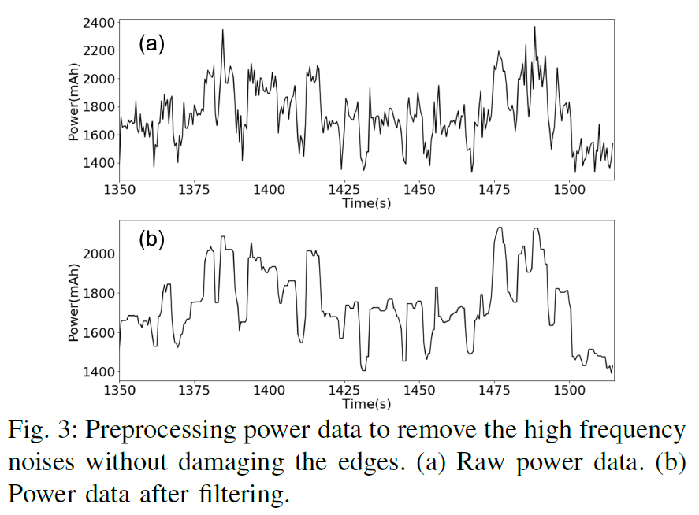
A. Pre Processing
Algorithm : Proposed IoT Security System
Input : Energy audit reading of the IoT device
Output: Whether the device is compromised
Preprocessing
Energy disaggregation
If applicable, the disaggregated performance metrics are compared with the ground truth to indicate which IoT component is not behaving normal.
System performance metrics aggregation for energy prediction
Anomaly detection based on the prediction error
The energy meter could accidentally lose some data samples, so an interpolation step is implemented.
The energy meter readings and collected system performance data are susceptible to noise.
Noisy data may have a negative effect on the model training. Hence the data needs to be smoothed.
The median filtering shown in the below Fig is a noise removal technique

Slide 14
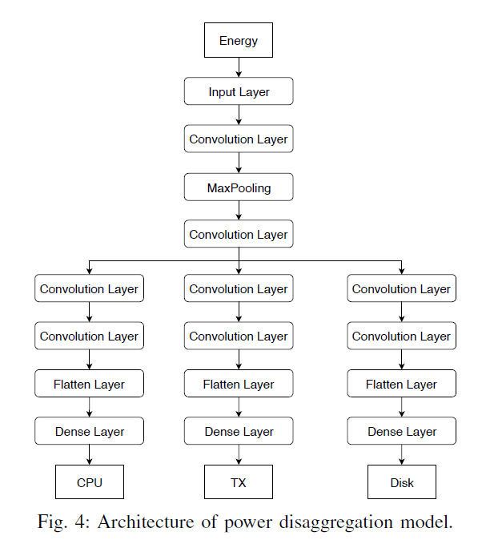
C. Disaggregation Model
Algorithm : Proposed IoT Security System
Input : Energy audit reading of the IoT device
Output: Whether the device is compromised
Preprocessing
Energy disaggregation
If applicable, the disaggregated performance metrics are compared with the ground truth to indicate which IoT component is not behaving normal.
System performance metrics aggregation for energy prediction
Anomaly detection based on the prediction error
Energy disaggregation is unidentifiable and thus a difficult prediction problem because more than 1 sources are extracted from a single observation.
The architecture of the disaggregation model is shown in Fig 4

Slide 15
Algorithm : Proposed IoT Security System
Input : Energy audit reading of the IoT device
Output: Whether the device is compromised
Preprocessing
Energy disaggregation
If applicable, the disaggregated performance metrics are compared with the ground truth to indicate which IoT component is not behaving normal.
System performance metrics aggregation for energy prediction
Anomaly detection based on the prediction error

Slide 16
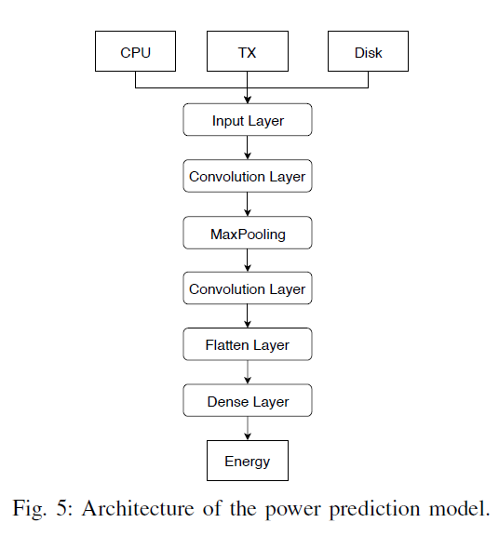
D. Aggregation based prediction model
Algorithm : Proposed IoT Security System
Input : Energy audit reading of the IoT device
Output: Whether the device is compromised
Preprocessing
Energy disaggregation
If applicable, the disaggregated performance metrics are compared with the ground truth to indicate which IoT component is not behaving normal.
System performance metrics aggregation for energy prediction
Anomaly detection based on the prediction error
A DL based aggregation model is proposed to predict the power consumption.
The architecture of the model is shown in Fig5

Slide 17
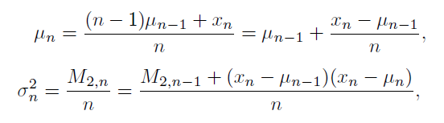
E. Anomaly Detection
Algorithm : Proposed IoT Security System
Input : Energy audit reading of the IoT device
Output: Whether the device is compromised
Preprocessing
Energy disaggregation
If applicable, the disaggregated performance metrics are compared with the ground truth to indicate which IoT component is not behaving normal.
System performance metrics aggregation for energy prediction
Anomaly detection based on the prediction error
The anomaly detection for the time series data is based on the statistical analysis.
A classic threshold for normal distribution data is 3σ.
Commonly μ ± 3σ is used to represent a normal data.
In the real time IoT security system, μ and σ vary from time to time, thus an online estimation is used:

Slide 18
APPLICATIONS
Providing security to Smart home components like smart speakers, home hubs, energy saving thermostats, smart video doorbells, smart plugs etc
Security to Iot wearables like fitness bands, GPS trackers, Panic buttons etc.
Securing smart city devices like LED lighting controls, Environmental sensors, etc
Not only these, even Smart grids, connected cars, smart retails, smart farming and other IoT applications shall be given security

Slide 19
CONCLUSIONS
A DL based IoT security system using energy auditing data is proposed.
The side channel energy meter readings detect not only the cyber attacks, but also the physical attacks and threats.
The dual disaggregation and aggregation DL models learn the normal performances of the IoT system and can also provide detailed analytics of the individual system performance metrics.
With the proposed approach. The IoT system will be better monitored and secured

Slide 20
REFERENCES
[1] Fangyu Li, Yang Shi, Aditya Shinde , WenZhan Song, “Enhanced Cyber-Physical Security in Internet of Things through Energy Auditing” IEEE INTERNET OF THINGS JOURNAL, VOL. X, NO. X, XX 2019
[2] H. A. Abdul-Ghani, D. Konstantas, and M. Mahyoub, “A comprehensive
IoT attacks survey based on a building-blocked reference model,” International Journal of Advanced Computer Science and Applications(IJACSA), vol. 9(3), 2018
[3] F. Li, A. Shinde, Y. Shi, J. Ye, X. Li, and W. Z. Song, “System statistics
learning-based iot security: Feasibility and suitability,” IEEE Internet of
Things Journal, pp. 1–8, 2019.

Slide 21
THANK YOU!

